Slide 1

ME 203 Introduction to MS Excel Lecture 3

Slide 2
Solvers
EXCEL has the capability to solve implicit problems
The two solvers are Goal Seek and Solver

Slide 3
Goal Seek
Allows you to solve problems backward
Find the result you want by adjusting the input value
Example
You know the flow velocity in a pipe cannot exceed 3 m/s; what pipe diameter will keep the flow at this velocity?
Need the final solution, a guess value, and a formula to compute the result

Slide 4
Goal Seek Example 1
To find the roots of a function:
Assign a cell for the independent variable x
Write formula for f(x) in another cell
Put an initial estimate of the root in the cell from step 1
Select Goal Seek function
Set cell – cell containing the function
To value – 0 (because at the root x, f(x)=0)
By changing cell – cell containing the independent variable x
Note: Whether or not goal seek converges to the root depends on your initial estimate

Slide 5
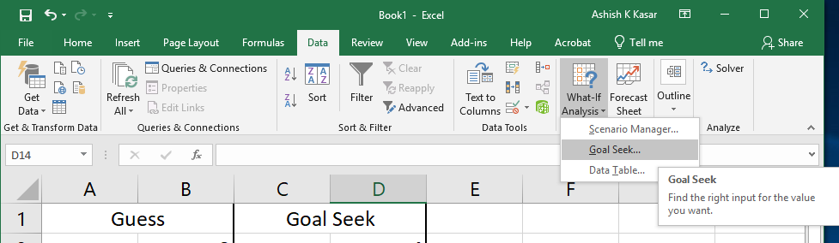
Goal Seek Example 1

Slide 6
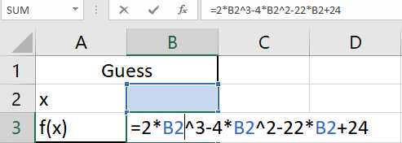
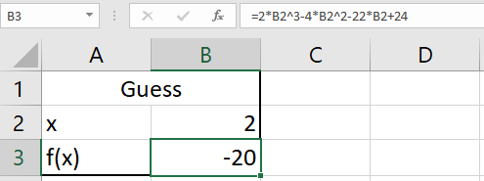

Goal Seek Example 1
Find the roots of $f\left(x\right)={2x}^{3}−{4x}^{2}−22x+$24
Use an initial estimate, say x=2. Corresponding f(x)=-20
Want to find x when f(x)=0
Step 1
Step 2
Step 3
Notes:
2,4

Slide 7
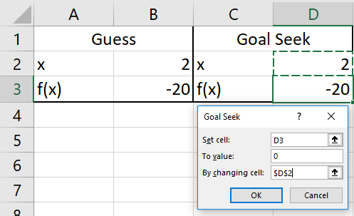
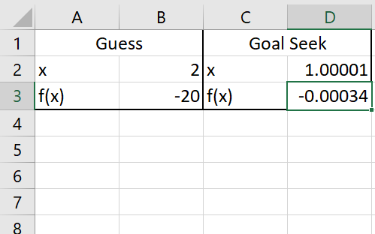
Goal Seek Example 1
Step 4
Result
Notes:
4,-3,1

Slide 8
Goal Seek
Note
The “By changing cell” should contain a constant numerical value. It cannot be a cell reference or a formula
Goal seek does not retain values from last operation. When you re-run goal seek, you have to fill in all the fields
Output of goal seek is a number in a cell. It is not automatically updated if any parameter involved in the calculation changes. In that case you have to re-run goal seek

Slide 9
Goal Seek Example 2
Your buying a vacation house that costs $225,000. The bank secured a loan at 6% annual interest and gave you a payment in order to pay off the loan in 60 months.
If you want to calculate your monthly payments…
Set up an excel sheet that lists the interest rate (6%), number of payments (60), principle ($225,000), and payment
Use the payment function built in to excel to calculate your monthly payment
Calculates the payment for a loan based on constant payments and a constant interest
=pmt(interestrate/12, number of payments, principle)

Slide 10
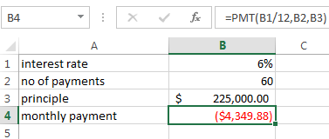
Goal Seek Example 2
Annual interest rate is given
Monthly rate = annual rate/12

Slide 11
What if the payment is too high and you can only afford $3000/month
Use Goal Seek to find out how many payments you would need to make in order to bring down your monthly cost to $3000

Slide 12
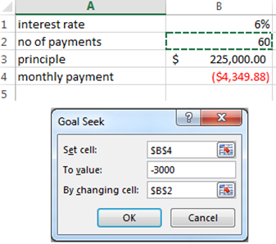
Navigate to Data>What-If Analysis>Goal Seek
Set cell=cell you want to change (Payment for this example)
To value=enter what you want your set cell to be
(-$3000) *Notice the negative value!!!
By changing cell=cell that is adjustable (# of Payment)
Note: The “By changing cell” should contain a constant numerical value. It cannot be a cell reference or a formula.

Slide 13
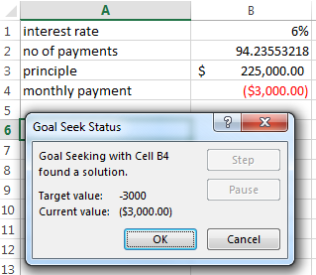
Goal Seek Example 2
Result

Slide 14
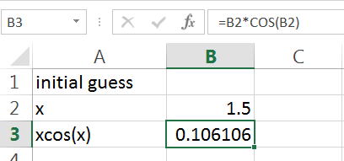
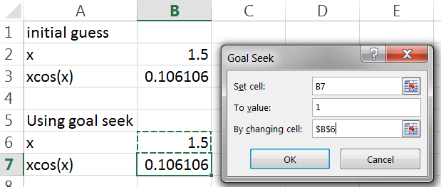


Goal Seek Example 3
Find x which satisfies the equation: $x\cos{x}=1$
Use an initial estimate, say x=1.5. Corresponding x*cos(x)=0.106106
We want to find x when x*cos(x)=1
Result

Slide 15
Solver Options
Powerful iteration tool
Works like Goal Seek
Activate the Solver
Excel>File>Options>Add-Ins

Slide 16
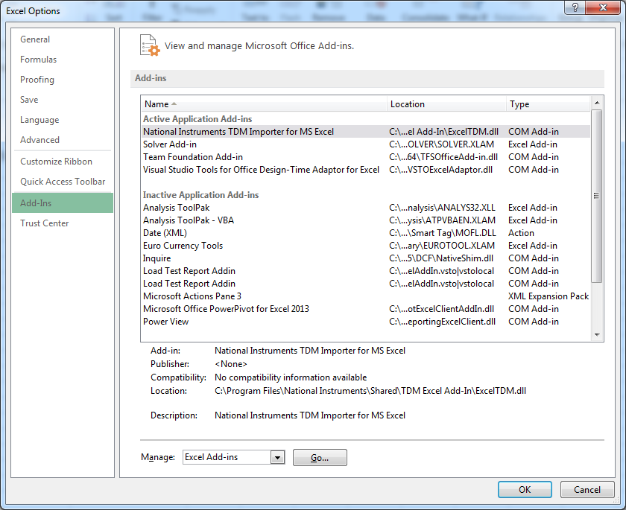
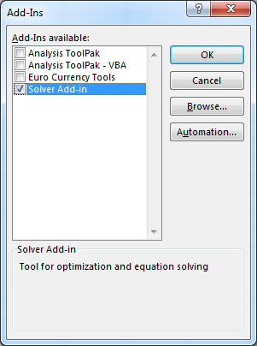
Enable Solver File>option>add-ins>Excel Add-ins>Solver Add-in>ok

Slide 17
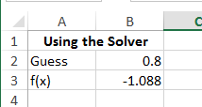
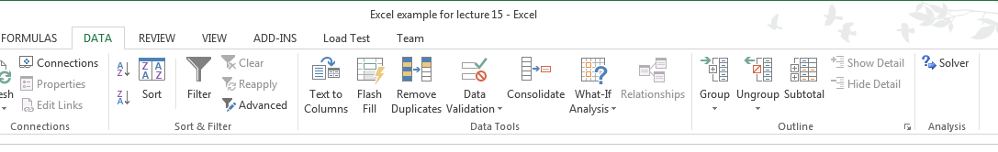

Solver Example 1
Find the roots of $x^{3}−17x+12=0$
Need to guess a value and enter the equation
Enter guess value 0.8
Enter the equation
Click Data>Solver

Slide 18
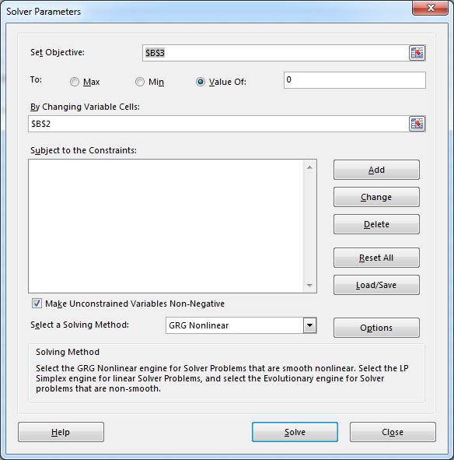
Solver Example 1
Equation
Set Objective = cell containing the equation you want to solve
Click Value of and set to 0
Set By Changing Variable Cells to the cell where you put the guess
Click Solve
Guess
Add extra constraints here

Slide 19
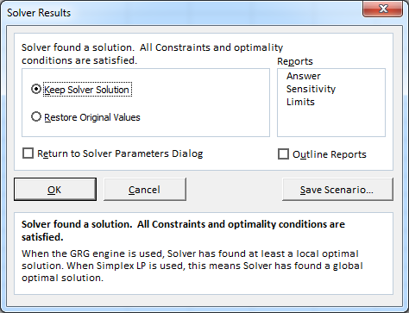
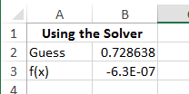
Solver Example 1
Solver will find a solution (hopefully). Click OK
Check your results
Notes:
0.72, 3.71, -4.43

Slide 20

Solver Example 2: Find the Maximum
Find the maximum of ${−x}^{3}+20x−5=0$
Need to guess a value and enter the equation
x | f(x)
1 | 14

Slide 21
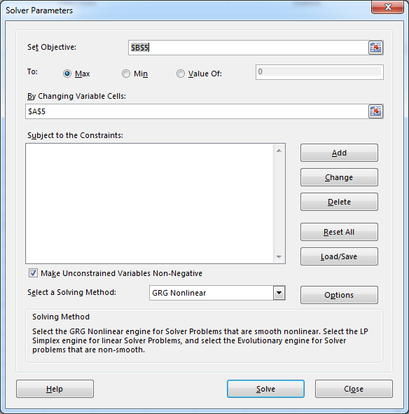
Equation, f(x)
Guess, x
Add extra constraints here

Slide 22
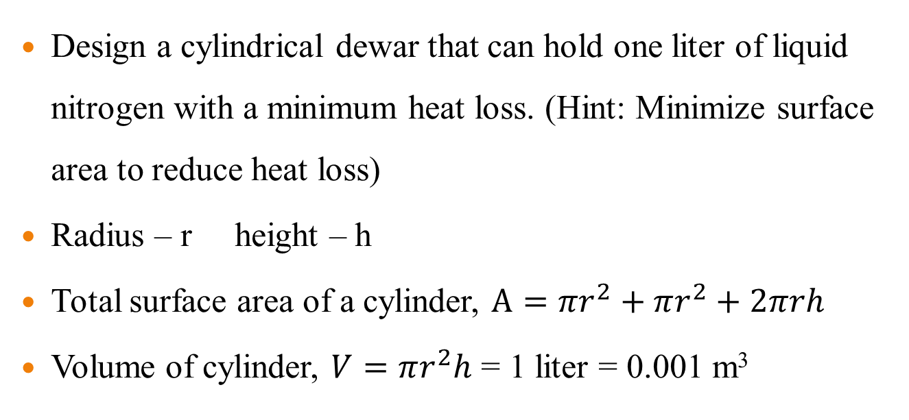
Solver Example 3
Design a cylindrical dewar that can hold one liter of liquid nitrogen with a minimum heat loss. (Hint: Minimize surface area to reduce heat loss)
Radius – r height – h
Total surface area of a cylinder, $A=πr^{2}+πr^{2}+2πrh$
Volume of cylinder, $V=πr^{2}h$ = 1 liter = 0.001 m³

Slide 23
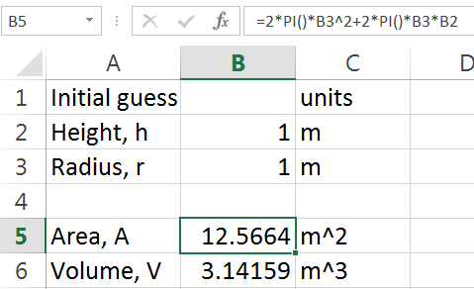
Solver Example 3
=2*PI()*B3^2+2*PI()*B3*B2
=PI()*B3^2*B2

Slide 24
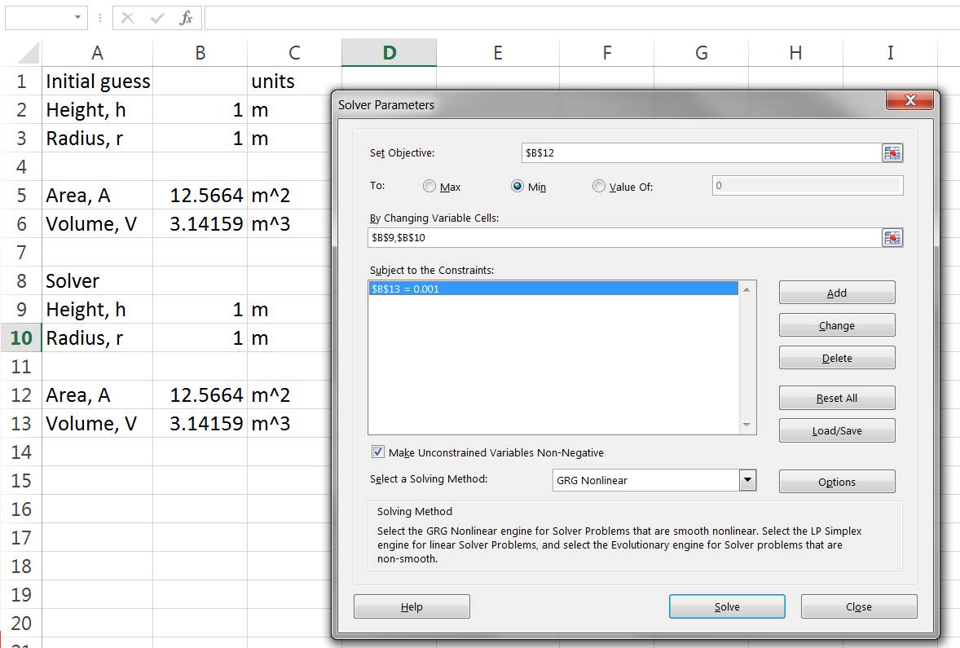
Solver Example 3

Slide 25
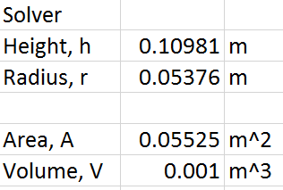
Solver Example 3
Result

